Slide 1

Building Transformational Cloud Native Applications
Adam Zwickey

Slide 2
The Power of PaaS (On Premise & Off Premise)
Business Value, Agility & Cost Savings
Traditional IT
IaaS
PaaS
You Manage
Applications
You Manage
Applications
Applications
Data
Data
Data
You Manage
Runtime
Runtime
Runtime
Middleware
Middleware
Middleware
Pivotal CF
+
Choice of IaaS
O/S
O/S
O/S
Virtualization
Virtualization
Virtualization
Servers
Servers
IaaS
Servers
Storage
Storage
Storage
Networking
Networking
Networking

Slide 3

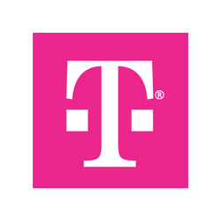

Tmobile BOOM PoC
Notes:
(bold moves)
2015 – This is..
The year where we see a level of adoption of our products and services that propels us to becoming an ipo-worthy company
This is..the year where our great vision becomes a reality in production environments at the most important companies and organizations in the world.
This is the year that we show and teach our customers and partners the power and opportunity that building great software brings.

Slide 4
PaaS features - Microservice architecture needs
Most of the requirements for implementing the microservices architecture are met by the PaaS platforms. PaaS reduces the complexity in building , deploying and operating microservices.
PaaS combined with right application development framework like Spring Cloud would provide an ideal combination for achieving microservices.
Pivotal Cloud Foundry (CF) Features
Environment Provisioning
On-Demand/Automatic Scaling
Failover/Resilience
Routing/Load Balancing
Data Service Operations
Monitoring

Slide 5
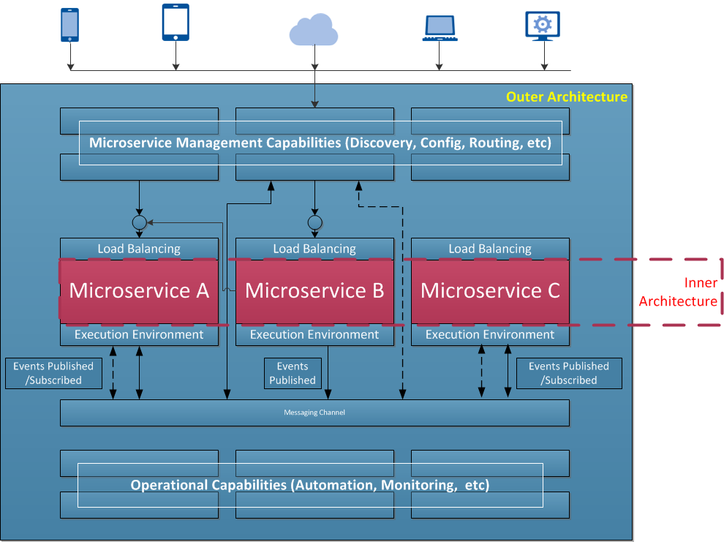
Role of PaaS in Microservices
The hardest part of building microservices is in the outer architecture (All of the blue boxed components).
Easiest part of the microservices is in the inner architecture. The architecture of an individual microservice.
PaaS platforms provide the outer architecture

Slide 6
BOOM POC using Pivotal CF - Microservices Concerns Mapping
Tooling
Configuration
Routing
Discovery
Monitoring
Bosh
Pivotal CF Router
Manifest Files
Eureka
Pivotal Health Manager
CF Cli
Data stores
Cassandra
Operational: Orchestration and Deployment Infrastructure
Jenkins
Pivotal Cloud Controller
Development : Languages and Containers
Node JS
Angular JS
Warden Container

Slide 7
CLOUDfoundry
Notes:
(bold moves)
2015 – This is..
The year where we see a level of adoption of our products and services that propels us to becoming an ipo-worthy company
This is..the year where our great vision becomes a reality in production environments at the most important companies and organizations in the world.
This is the year that we show and teach our customers and partners the power and opportunity that building great software brings.

Slide 8
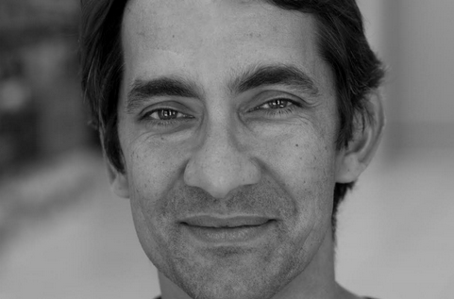
Cloud Foundry Foundation
$6M/year to promote CF
40 Fortune 500 brands
Wall Street Working Group
IoT Working Group
Cloud Foundry Summit, May 11-12
Get your customers involved, own the next generation of IT
The Cloud Foundry Foundation was formed in early December of 2014, and already it has found a leader. Sam Ramji was announced as the new director of the Cloud Foundry Foundation this morning.

Slide 9
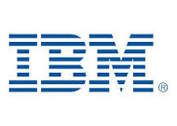
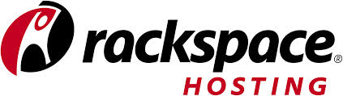
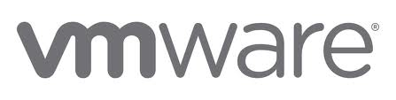
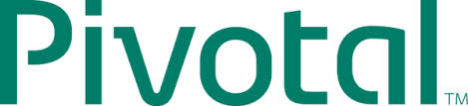
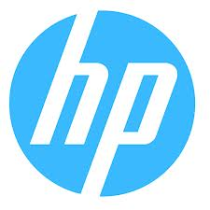
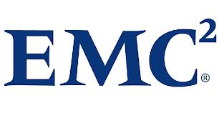
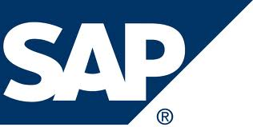

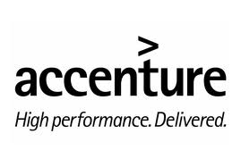
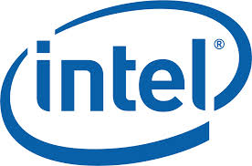

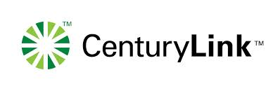
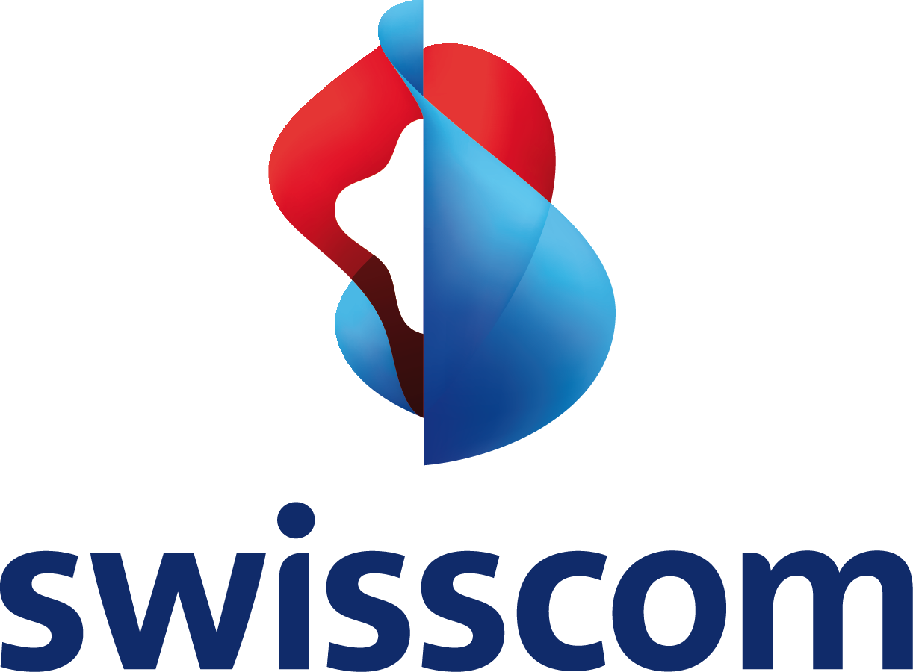

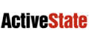
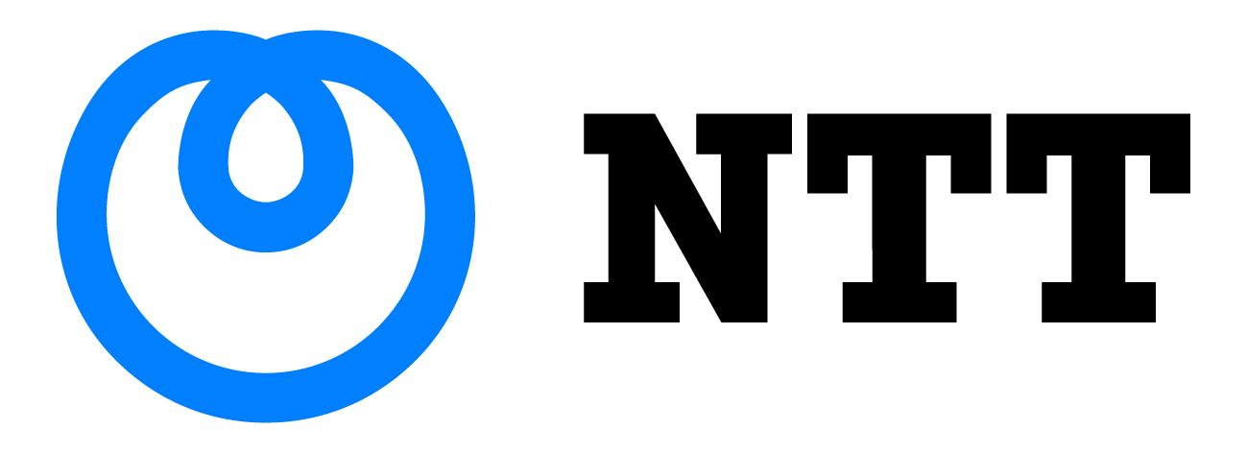
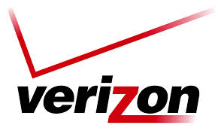

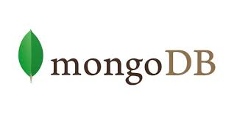
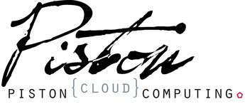
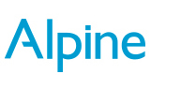
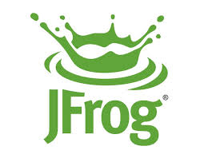
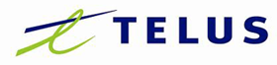


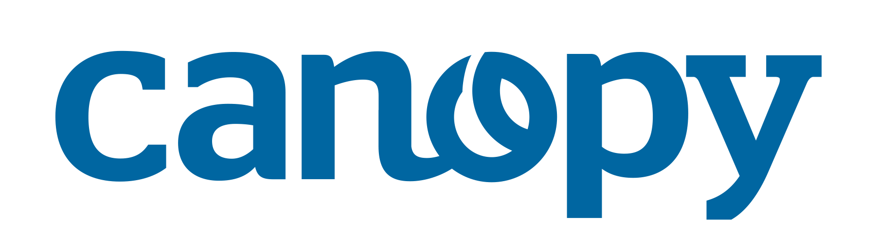
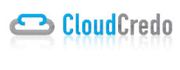
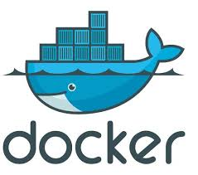

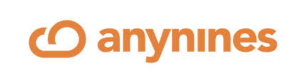
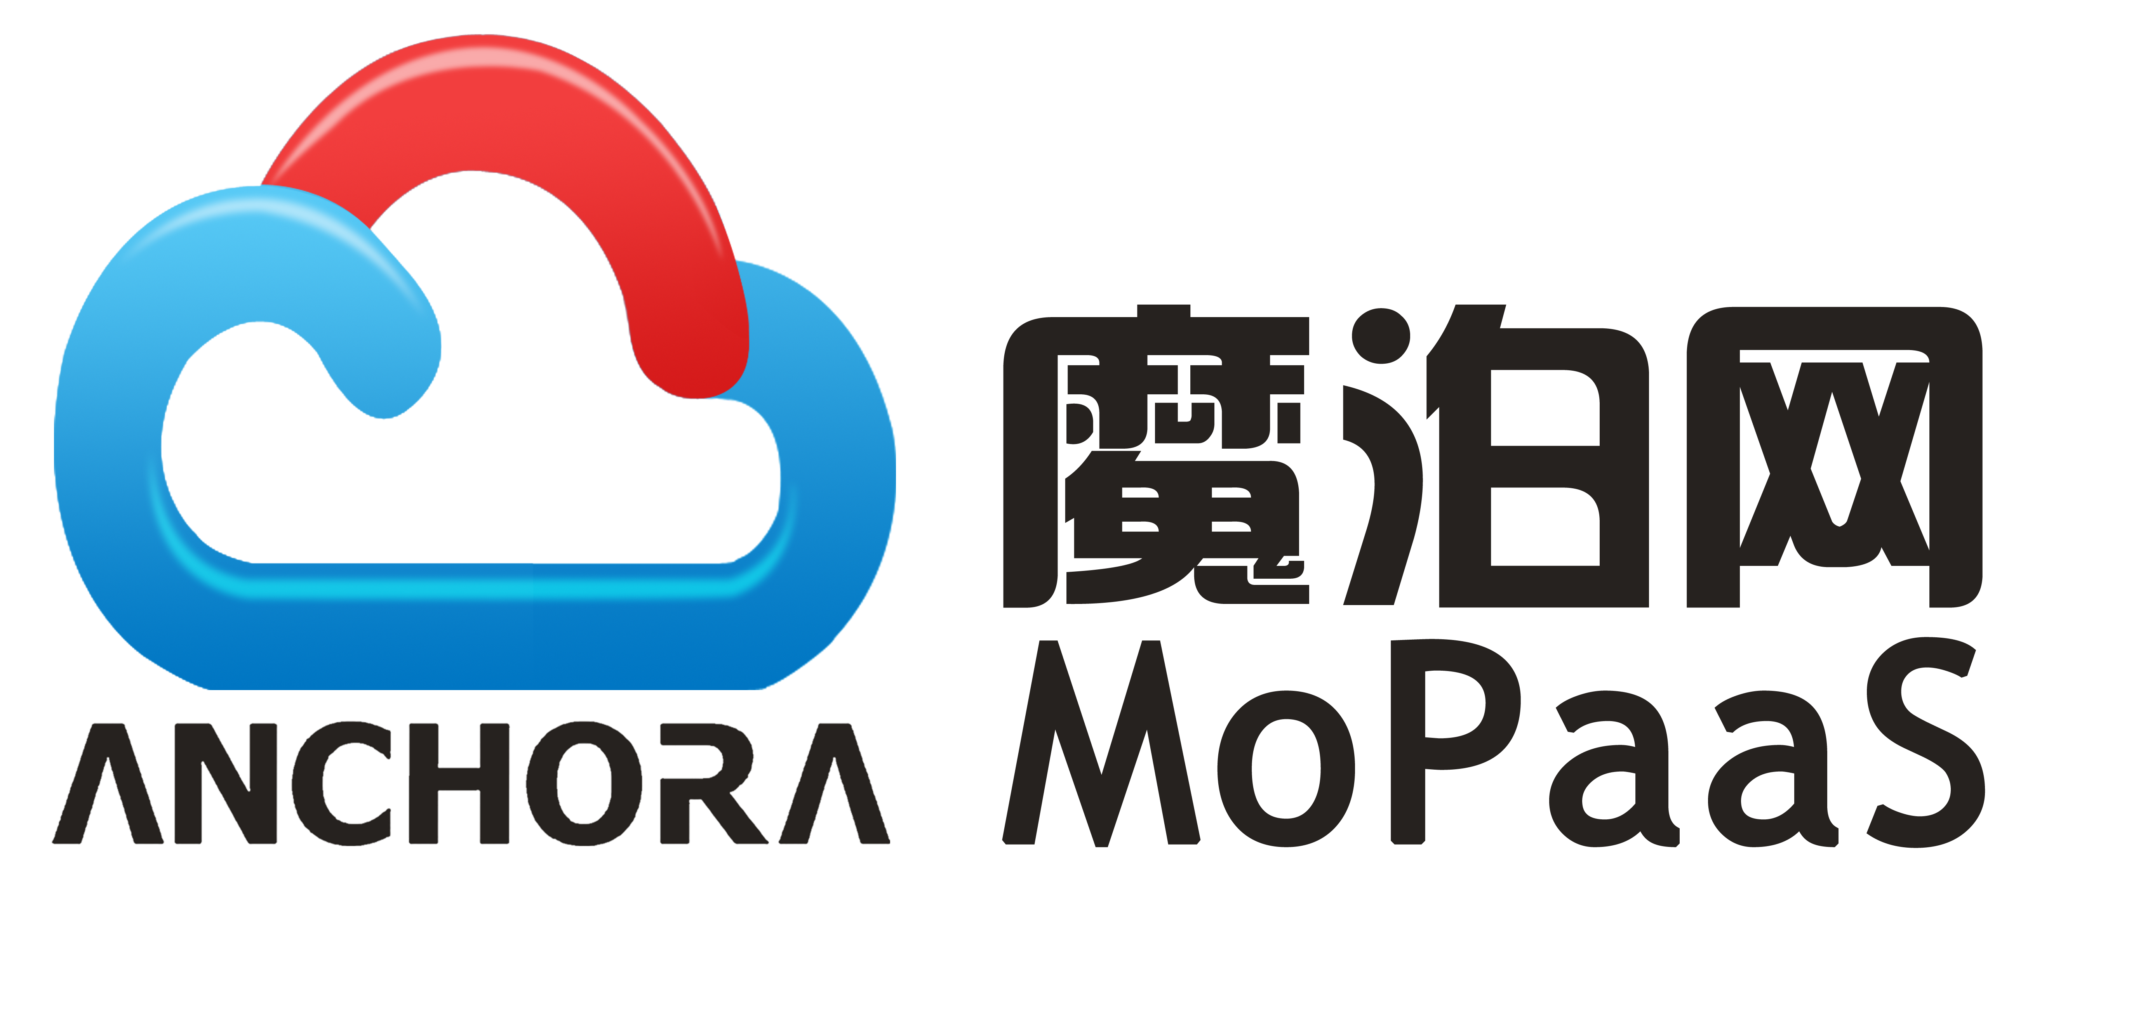
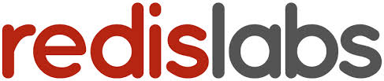
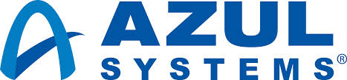
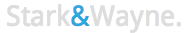
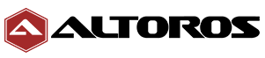
Cloud Foundry: The Industry’s Open Cloud Standard
Gold
Silver

Slide 10
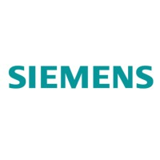
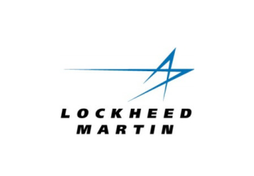
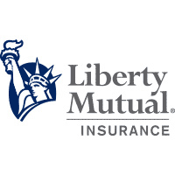
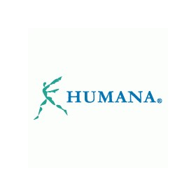
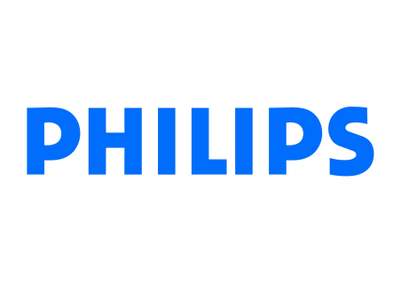

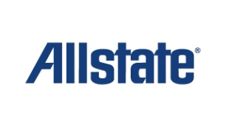

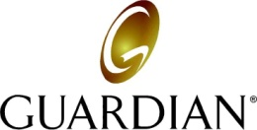




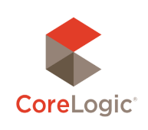
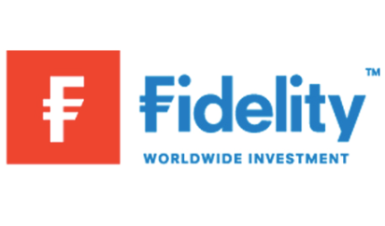
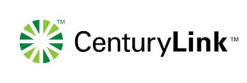
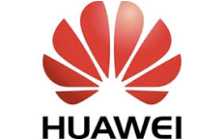

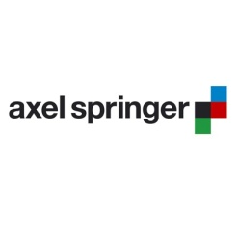
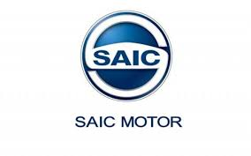
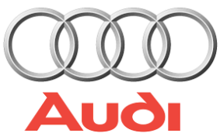
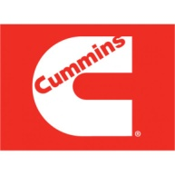


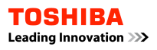
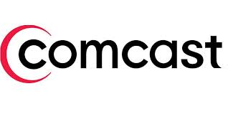


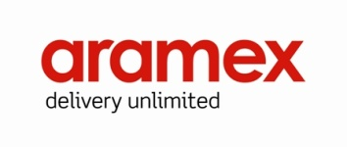



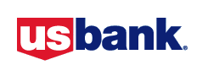



WORLDWIDE, CROSS-VERTICAL CUSTOMER ADOPTION
Internet of Things
Insurance
Telecommunications
Financials
Automotive / Industrial
Media
Education
Banking
Retail/Delivery
Government
Notes:
While everyone agrees the new slides looks much more organized and its easier to find the verticals and the logos, here are some points of feedback
The Retail and Education sections were missed totally (most people did not find them until I pointed it out)
The vertical organization could be alphabetically sorted
Need a way to avoid the white space
I went through another round of classification and also sorted alphabetically. Feel free to re sort if I missed something.

Slide 11

Pivotal Cloud Foundry Industry’s Leading Open Cloud Solution
Notes:
PCF has two main audiences – Developers and Operators
For Developers
Faster Time To Market
Mobile + Data Services
Agile and Iterative
Leverage OSS
For Operators (Talk to slide)
Continuous Delivery
No Downtime
Instant scaling
Consistency & Automation

Slide 12







Anatomy of a Cloud Native Platform
1. Application Framework
Developer
Contract – 12 Factor App
2. Container Runtime
Dev+Ops
Contract – BOSH Release
IT Ops
3. Infrastructure Automation
Contract – Cloud Provider Interface
4. Infrastructure
IT Ops
“Contracts” between Applications, opinionated frameworks like Spring Boot and Spring Cloud and opinionated Cloud Native Platforms like Cloud Foundry help significantly accelerate the development of Cloud Native applications
Notes:
That is and should be a governing principle behind any cloud platform, library, or tool. Spring Cloud–an open-source library–makes it easy to develop JVM applications for the cloud. With it, applications can connect to services and discover information about the cloud environment easily in multiple clouds such as Cloud Foundry and Heroku. Further, you can extend it to other cloud platforms and new services.
Application Framework
Spring Cloud : used by Netflix
Spring Boot now over 1M downloads a month, historic levels of growth
Runtime platform
Cloud Foundry elastic runtime used by top FS leaders
Enterprise production ready Linux Container based platform
Infrastructure Automation
CF BOSH: Embedded OS, cloud API integrated
Incredible operational leverage; machine to machine automation

Slide 13

Extensive services ecosystem
Core PCF Services
MySQL HA
Redis
RabbitMQ
PHD
HAWQ
Spring XD (beta)
Session-State Caching (beta)
Partner Services
Jenkins
RiakCS
Cassandra
MongoDB
Neo4j

Slide 14






Deployment models aligned to your needs
Public
On
Premise
We manage
You manage
Notes:
Talk about how its different from PCF on AWS

Slide 15
















Pivotal CF: Technical Capabilities
Automatic App Server & OS Configuration with Buildpacks (“just push your app”)
Application
Containerization & Cluster Scheduling
Application Network Security Groups
App Health Management, Load Balancing,
Rapid Scaling, Availability Zones
Application to Services Binding and Access
Policy, Identity and Roles Management
Logging as a service,
Application metrics & performance,
Metric based scaling
Native & Extended Data, Mobile and Platform Services
IaaS Provisioning, Scaling & Configuration
Deploy, Operate, Update & Scale with minimal downtime on choice of IaaS
….and more
Notes:
Key Platform Capabilities
On Demand Scaling
Application Health Management
Dynamic Routing & Load Balancing
Log and Metric Aggregation
Security
WHAT
Pivotal CF is next generation middleware that delivers 9 things that are typically delivered via point software products.
We provision operating systems and middleware.
We deliver workload density without compromising application performance.
We ensure that applications have appropriate network security safe guards to prevent security threats.
We support application connections to external sources including databases and legacy middleware.
We provide 4 levels of HA, with built in load balancing for scale in/out
We support multi-tenant environments so that each line of business can operate with a discrete quota and isolated system access.
We provision next generation data services including NOSQL databases, traditional databases and hadoop clusters.
We provide horizontal and vertical scaling for the underlying IaaS so that you can scale your infrastructure in lock step with your Business.
We provide a built-in log aggregation service, built-in APM metrics and utilization based auto-scaling so that you can monitor the health of your applications and scale out without human or 3rd party tool intervention.
I am going to cover each of these 9 capabilities in more detail, but it’s important to note the impact of this collection of capabilities. The following slides will include information on CAPEX and OPEX reduction. We will also discuss how you can deliver faster time to value while holding the line on infrastructure cost.

Slide 16
D e m o
Notes:
(bold moves)
2015 – This is..
The year where we see a level of adoption of our products and services that propels us to becoming an ipo-worthy company
This is..the year where our great vision becomes a reality in production environments at the most important companies and organizations in the world.
This is the year that we show and teach our customers and partners the power and opportunity that building great software brings.

Slide 17











Cloud Foundry Architecture
Internet
Dynamic Router
The Cloud Foundry platform is abstracted as a set of large-scale distributed services. It uses Bosh to operate the underlying infrastructure from IaaS providers (e.g., VMware, Amazon AWS, OpenStack).
Cloud Controller
UAA/Login Servers
Health Manager
Service Broker Node(s)
DEA Pool
Apps
User Provided
Service Instances
Build Packs
PaaS
Logging
Service Broker(s) – Bind internal/external Services to Applications
DEA – “Droplet Execution Agent”. Secure and fully isolated containers responsible for an App’s lifecycle: building, starting and stopping Apps as instructed.
Messaging (NATS)
Cloud Foundry BOSH
Underlying
Infrastructure
Notes:
Cloud Foundry PaaS
An application runs in a DEA, which is a droplet execution agent. The Cloud Controller orchestrates the routing and lifecycle of all DEAs in the pool. Routers manage application traffic. Health Manager reports mismatched application states to the CC. A service gateway provides an interface for services (native or external). A messaging bus manages all system communication. Apps are accessed directly through the router while web and CLI clients (e.g., vmc, STS) access Cloud Controller via RESTful services.

